Slide 1





Defect Prediction: Final Presentation!
Rishika Baichwal & Yash Agarwal

Slide 2

Risk Prediction Methodology
Commit Mining: Extract commit metadata, file diffs, and developer stats (PyDriller).
Bug Fix Detection: Identify fixing commits using keyword-based heuristics.
File Risk Factors (After Ablation Testing):
Recent bug activity (log-decayed)
Modification frequency
Bug-fix history
Code churn (added/deleted lines)
Developer experience (time in project)
File import centrality
Weighted Aggregation: Combine features using variance-based dynamic weighting.

Slide 3
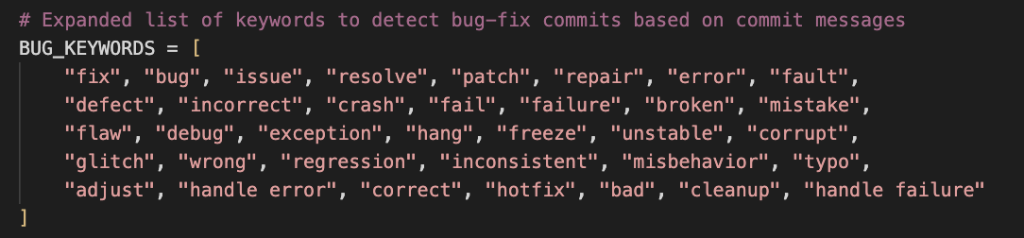
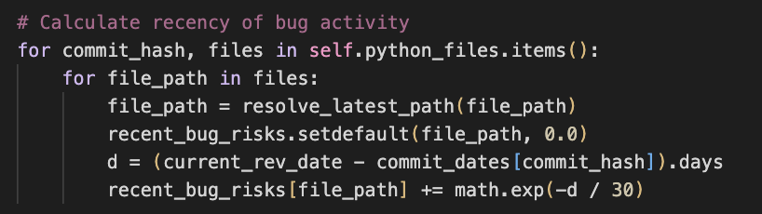

Key Changes and Insights
Simplification: Removed noisy features like import frequency using ablation testing.
Code Changes:
Expanded bug-fix keyword list for better detection.
Enhanced the scoring method for recent bug activity to better prioritize newer issues.
Insight: Simpler models with fewer but meaningful features often performed better.

Slide 4
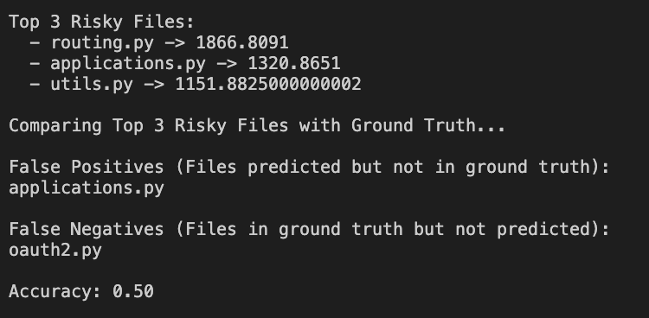
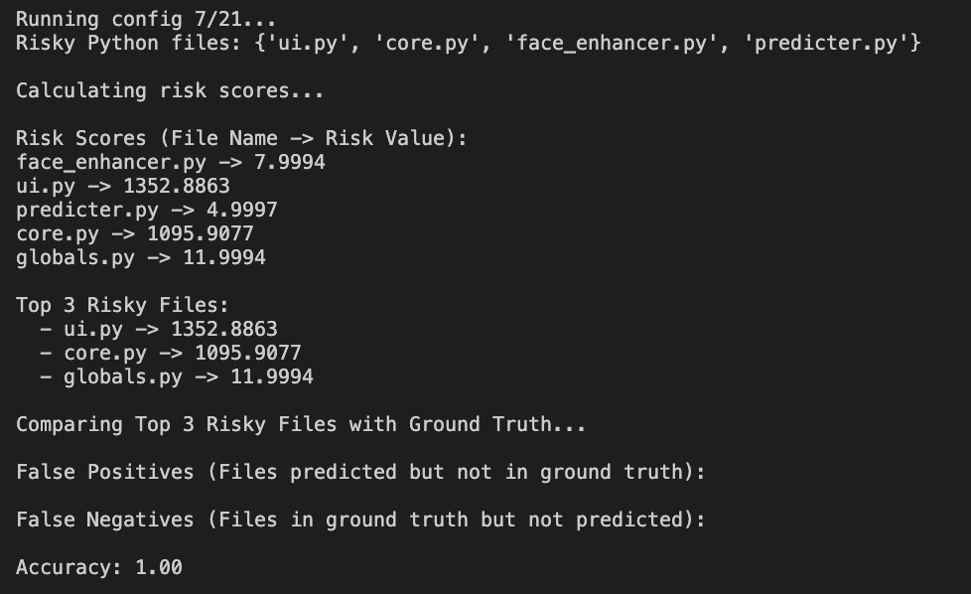
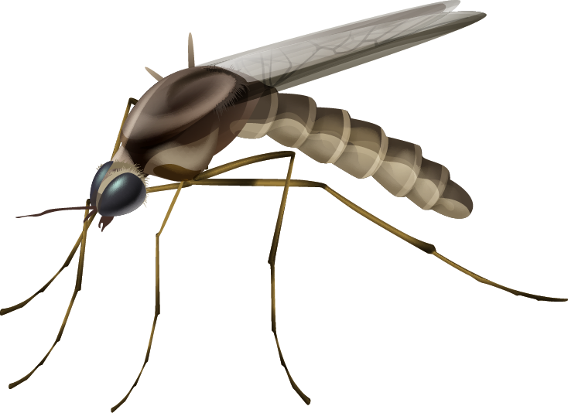
Results & Takeaways
Model Works: Generates dynamic risk scores with no manual tuning needed for different repos.
Critical Features:
Bug-fix History
Modification Frequency
Key Insights:
Simpler models can perform just as well as complex ones.
Thoughtful feature selection is more important than adding many features.

Slide 5
Our Timeline
Week 1: Initial Setup ✅ | Read research papers & understand defect prediction concepts.
Week 2: Data Collection ✅ | Run RepoMiner, extract commit history, and ensure proper data retrieval from multiple repositories.
Week 3: Algorithm Research & Implementation ✅ | Compare defect prediction models and implement an initial risk scoring formula.
Week 4: Implementation ✅ | Finetune parameters in current algorithm for success across repos
Week 5: Model Refinement & Testing ✅ | Test on multiple repositories, refine ranking system
Week 6: Final Optimizations ✅ | Optimize performance, clean up the code, prepare for final product.

Slide 6

Thank you!

